Slide 1

A Force For Good: How TrueBlue is “Accelerating” Connecting People with Work
Carter McHugh & Jeff Dirks

Slide 2
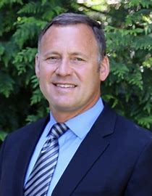
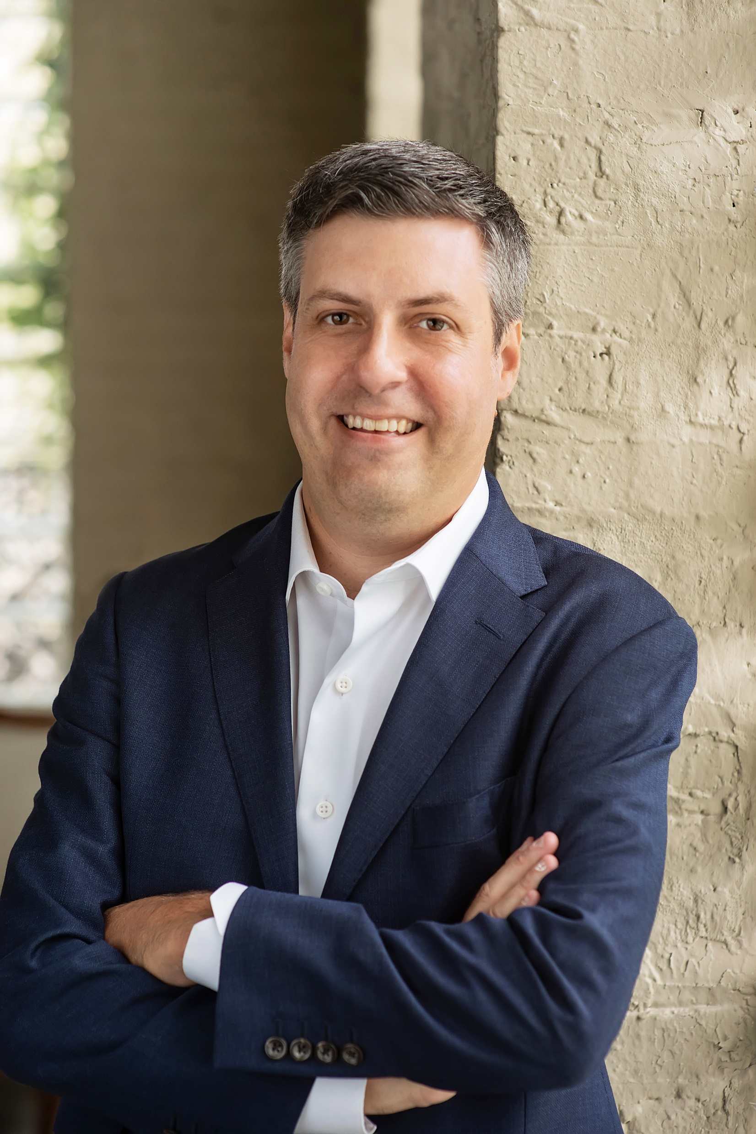
Speaker Introductions
Jeff oversees all business product software and cloud R&D, analytics and data science, enterprise applications, cybersecurity, and IT infrastructure services and cloud platform services for TrueBlue’s global technology organization.
3 decades leading high growth technology and business teams
Passionate for growing businesses through power of technology
University of Washington, Computer Science & Germanic Languages
Military Veteran – U.S. Army
Resides in Bellevue, Washington
Jeff Dirks, CTO/CIO
Carter leads PeopleScout’s global technology organization including product R&D and operations for the award winning Affinix technology platform.
2 decades leading product technology build and run teams
Passionate for leading team in systems thinking and lean engineering
Enterprise DOES attendee (2016-2021)
University of Illinois, Computer Science
Resides in Greater Chicago Area
Carter McHugh, VP Technology

Slide 3
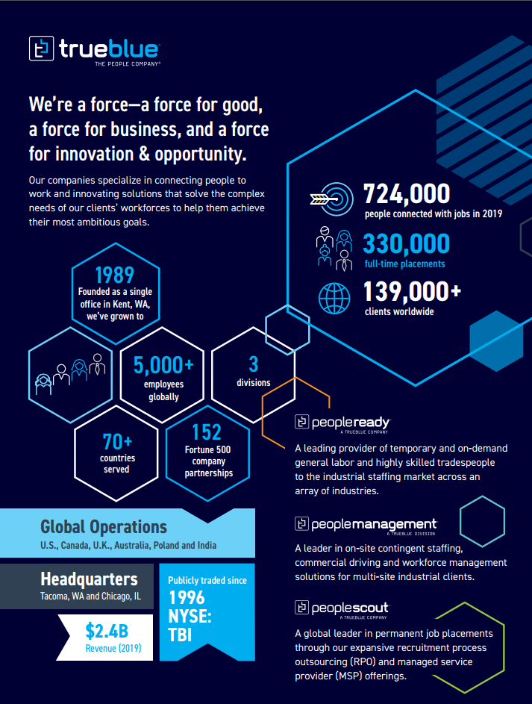
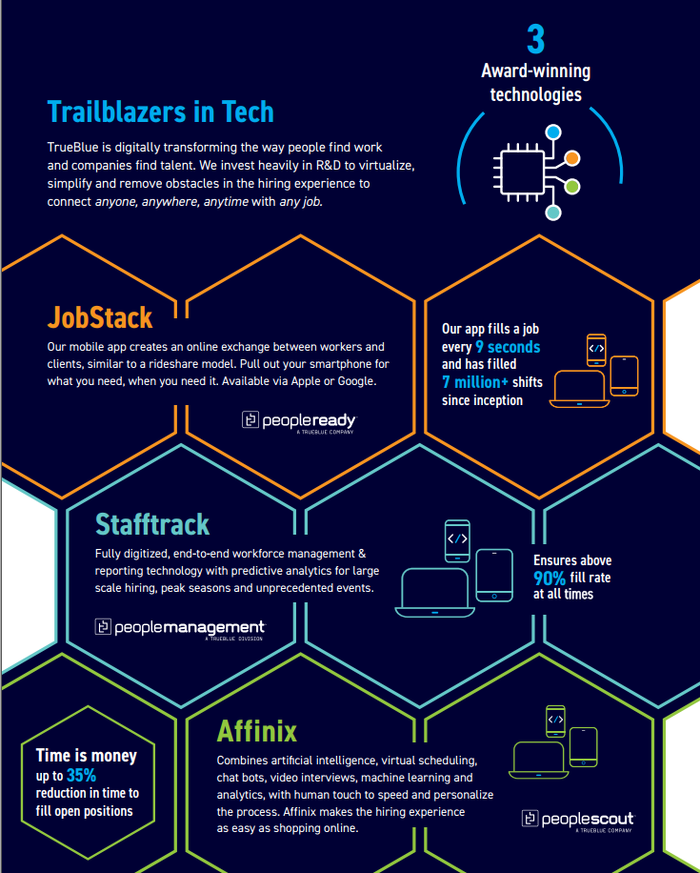

Slide 4






2018 - Challenges Faced at TrueBlue
Revenue Stagnates
Margins Erode
Cost Cutting
Overwork
Defensive Strategies
New Ideas!
Customer Needs!
Growth!
Business accelerates
Flywheel of
decay
Danger Zone!
Ripe for Disruption
Technology bunkers
Optimized for Cost
(Not Speed)
Understaffed
(SPOF)
Brittle Infrastructure & Tech Debt
(Deferred Expenses)

Slide 5



2019 - Where We Started
Two Pizza Teams!
We Reorganized!
Are We Better? At What?
Public Cloud!
We Migrated!
Do we better understand the business needs?
DevSecOps!
We Bought Tools!
Do we more efficiently deliver greater value?
Run What You Build!
We Bought Tools!
Do our business partners better understand
and value us?
Continuous Delivery!
We Bought Tools!

Slide 6


2020 - Introducing Data Driven Purpose and Guidance
Initially, we had many opinions…..but far fewer facts.
We needed purpose and guidance beyond….
because do it!
We all read Accelerate. It gifted us data-driven insight into high performance organizations.
Suddenly, we were armed with facts…..what performance levers we should measure against.
Lead Time (2) Deployment Frequency
(3) Mean Time To Restore (4) Change Fail Percentage
We set organization wide goals:
Every team would baseline their current metrics and measure quarterly.
No universal improvement targets were set. Each team made their own commitments.
Some teams were green-field and set very aggressive targets.
Some teams were legacy and set modest improvement targets.
Visibility Required. Teams published their metrics each quarter and shared learnings.

Slide 7


It’s a Compass…not a Map
1. Increased Deploy Frequency
2. Lower Change Fail Rate
3. Faster MTTR
4. Shorter Lead Times
The difficult truth was…..
We. Didn’t. Know.
We have a compass: Measure, try, correct.
Think big, work small.
Optimize for forward momentum.
What constitutes a deployment?
Doesn’t every team need to measure the same?
Doesn’t this reward poor quality?
Does this mean CM doesn’t apply?
Our customers and partners are happy with our current cadence.
Shouldn’t we measure for business value?
What teams discovered

Slide 8
2021: Measuring the Impacts
Revenue Growth
Margins Expansion
Strategic Investments
Empowered Teams
Sustained Delivery
10x
4x
Total Changes Deployed
Flywheel of Innovation & Growth
13 %
30 %
Time Spent in KTLO
6%
10%
LOB to IT Shared Spend Ratio
+4
+7
Employee Satisfaction Scores
2020
2021

Slide 9

A Journey of a Thousand Miles Begins with a Single Step
Transformations are intimidating
Leaders are vocal and opinionated
Laggards are quiet and invisible
Start your journey wherever you are
Setting Goals
Measuring Effectively
Communicating Effectively
Gaining Executive Buy-In
What’s next for TrueBlue…..?
We’re learning to solve business problems.
We’re investing in Empowered Product Teams.
We’re investing in Discovery.
We’d love to connect!

